Slide 1
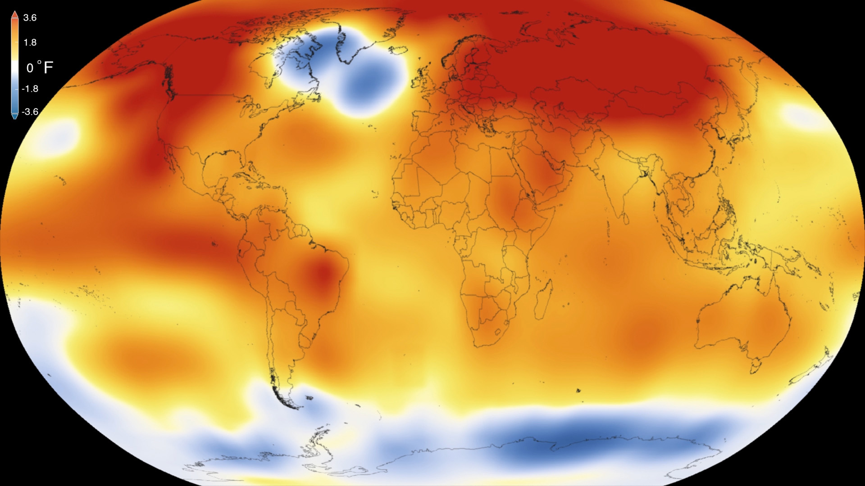
Analyzing Climate Variability Effects on Energy Usage Trends
By Ouardia Manel Ait Amer

Slide 2
My Columns Meaning:
Timestamp: The timestamp of the weather data.
Humidity: Humidity level.
Snow: Snowfall amount.
Windspeed: Wind speed.
Winddirection: Wind direction.
Count: This column seems to represent a count of some event or occurrence.
TempC: Temperature in Celsius.
TempminC: Minimum temperature in Celsius.
TempmaxC: Maximum temperature in Celsius.
Precipitation: Amount of precipitation (rainfall) in millimeters.
Date: Date of the weather data.
Hdd12: HDD (Heating Degree Days) calculated for a 12-hour period.
Hdd15: HDD (Heating Degree Days) calculated for a 15-hour period.

Slide 3
How did I use my DataFrame?
Climate change Analysis:
Exploring the historical weather data available in your DataFrame.
Analyze temperature data to identify trends in global warming.
Communication and visualization are essential aspects of weather analysis, allowing you to convey insights effectively to stakeholders and decision-makers.
Establish a relationship between wind energy production and rain precipitation by analyzing historical data on wind energy production and rain precipitation.
Hypothesis on Effect of Humidity on Renewable Energy Generation:
Higher humidity levels negatively impact renewable energy generation.
It affect renewable energy generation in various ways:
Solar Energy Generation:
High humidity levels can lead to increased water vapor in the atmosphere, which can scatter sunlight and reduce solar irradiance reaching solar panels. This reduction in sunlight intensity decreases the efficiency of solar panels and reduces solar energy generation.
Wind Energy Production:
While humidity itself does not directly affect wind speed, it can influence atmospheric stability and density. As wind speed is a critical factor for wind energy production, higher humidity levels may result in decreased wind energy generation.
Hydropower Generation:
Humidity is closely linked to precipitation, which plays a significant role in hydropower generation. High humidity levels can contribute to increased moisture in the air, leading to more frequent precipitation events.

Slide 4
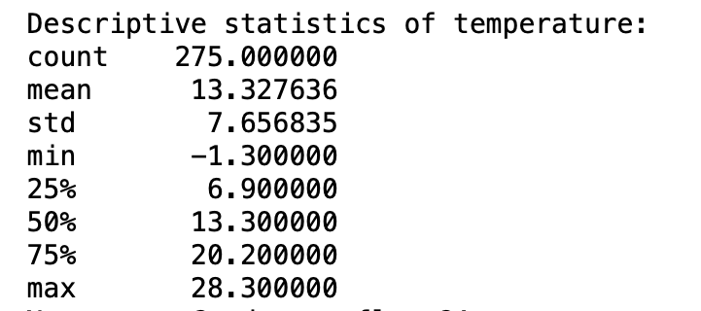
Descriptive Statistics:
Descriptive statistics of numerical data provide summary measures that describe the central tendency, dispersion, and shape of the dataset.
Descriptive statistics provide a concise summary of the essential characteristics of numerical data, facilitating data interpretation, comparison, and decision-making in various fields such as finance, economics, social sciences, and engineering.

Slide 5
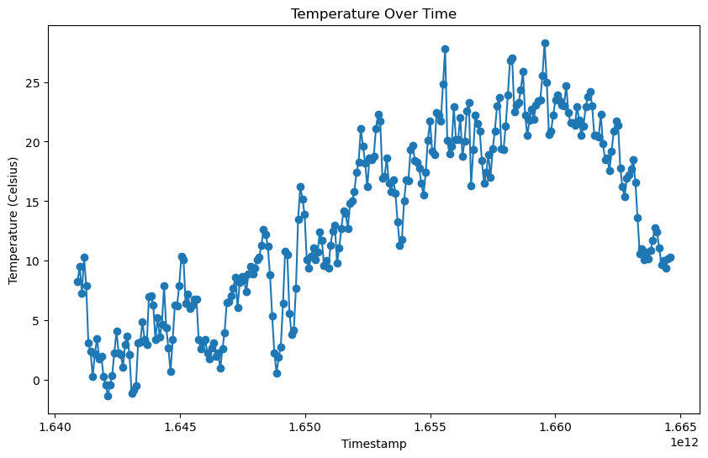
Time Series: Temperature Analysis
df['timestamp'] specifies the x-axis values, representing the timestamps or dates.
df['tempC'] specifies the y-axis values, representing the temperature values in Celsius.
Overall,this is a time series plot of temperature data over time, allowing us to visualize the trend and fluctuations in temperature throughout the observed period.
It helps in identifying patterns, seasonality, and anomalies in the temperature data.

Slide 6
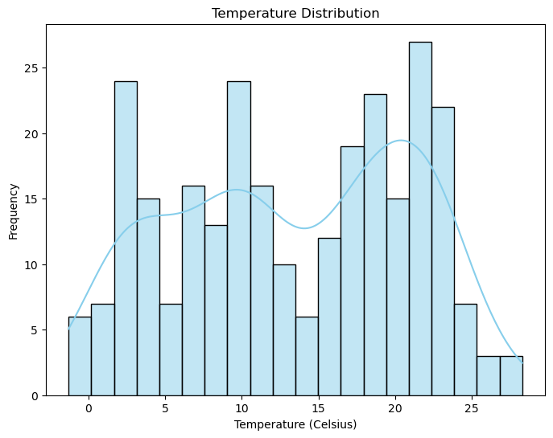
Temperature Distribution Analysis:
The histogram helps visualize the spread and shape of the temperature data, highlighting any central tendency and variability in temperature values.
The addition of the KDE curve provides a smooth estimation of the underlying probability density function

Slide 7
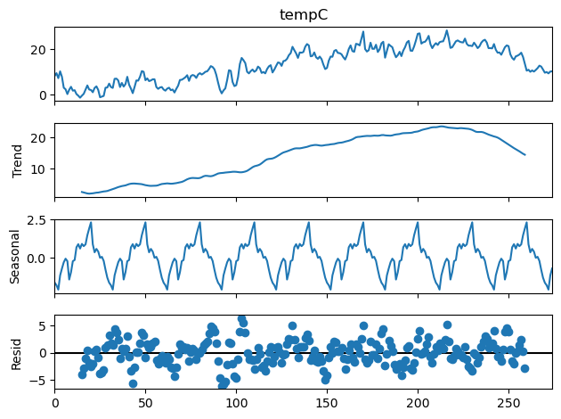
Seasonal Decomposition of the Temperature:
This line imports the seasonal_decompose function from the statsmodels library, which is used for decomposing time series data into seasonal, trend, and residual components.
Seasonal Period in simpler terms, the seasonal patterns in the temperature data are expected to repeat every 30 time units.
model='additive' specifies the decomposition model. In additive decomposition, the observed data is assumed to be the sum of seasonal, trend, and residual components.
Seasonal Component: Represents recurring patterns or cycles in temperature that occur over the specified period (30 days in this case).
Trend Component: Indicates the long-term direction or trend in temperature data, reflecting overall changes over time.
Residual Component: Represents the remaining variation in temperature data after accounting for the seasonal and trend components, often reflecting random fluctuations or irregularities.

Slide 8
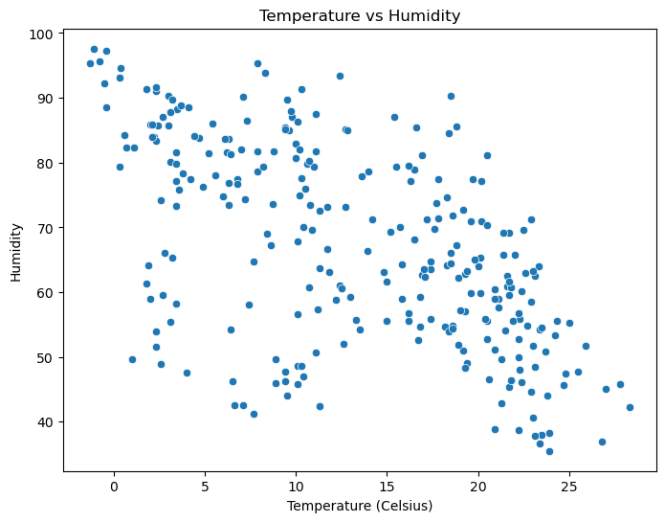
Correlation Analysis between Temperature and Humidity :
Explore relationships between temperature and other variables such as humidity, precipitation, wind speed...
Calculate correlation coefficients and visualize correlations using scatter plots or heatmaps to identify any significant associations.
The correlation coefficient quantifies the strength and direction of the relationship between two variables. It ranges from -1 to +1.
It is used to make predictions and hypothesis. Additional research and analysis are often needed to establish causal relationships.

Slide 9
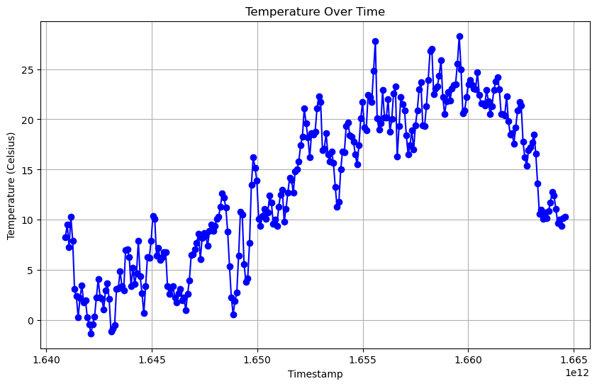
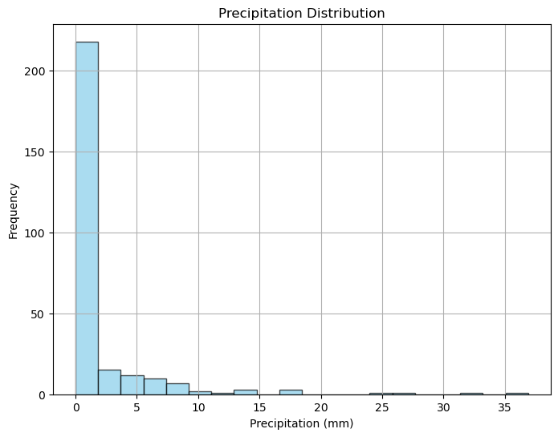
Communication and Visualization:
This plot shows how the temperature changes over time.
Each data point on the plot represents a temperature measurement at a specific timestamp.
The blue line connects these data points, providing a visual representation of the temperature trend over time.
This plot visualizes the distribution of precipitation values.
The plot consists of bars, where each bar represents the frequency of precipitation values falling within a particular range.
Grid lines are enabled to assist in reading and interpreting the plot.

Slide 10
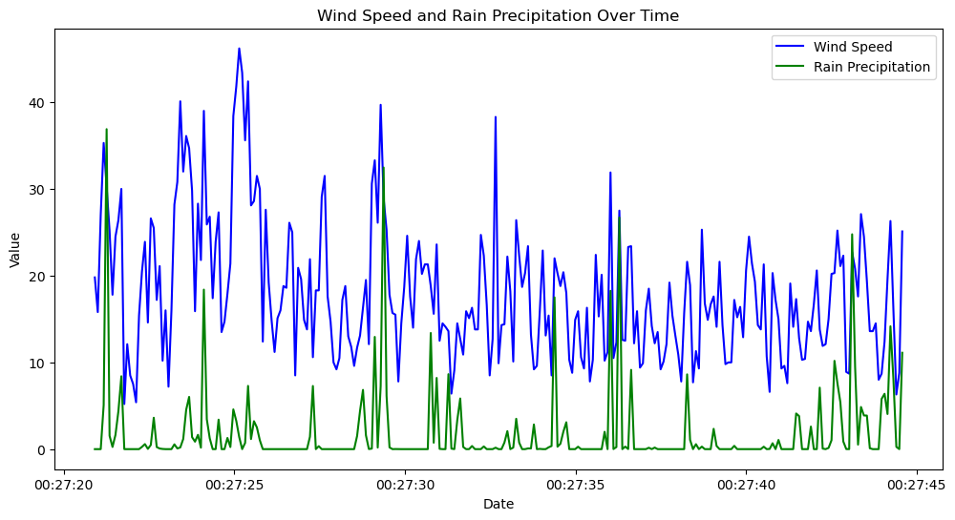
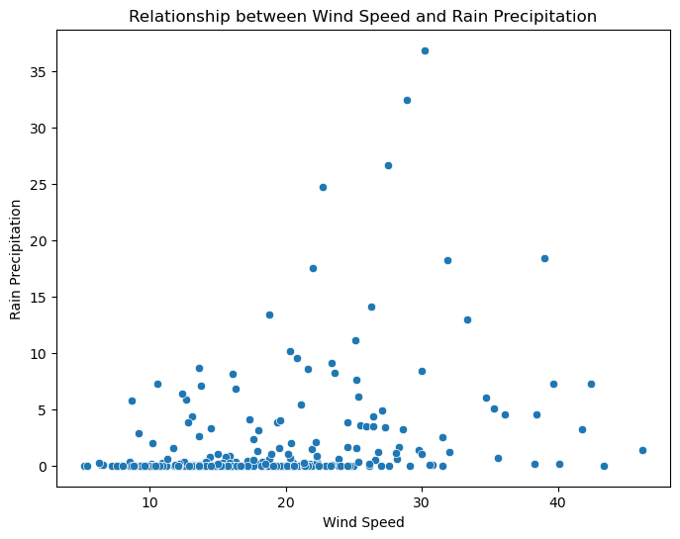
Relationship between wind energy production and rain precipitation:
The line plot visualizes how wind speed and rain precipitation vary over time. This helps identify any long-term trends or patterns in the data.
Overall, the goal is to gain insights into how wind speed and rain precipitation interact over time, allowing for a better understanding of their relationship and potential impacts. This analysis may be useful for various applications, such as weather forecasting, climate studies, and renewable energy planning.
My goal was to see how wind speed and rain precipitation can impact renewable energy planning in several ways such:
Resource Assessment.
Wind Energy Production.
System Integration.

Slide 11
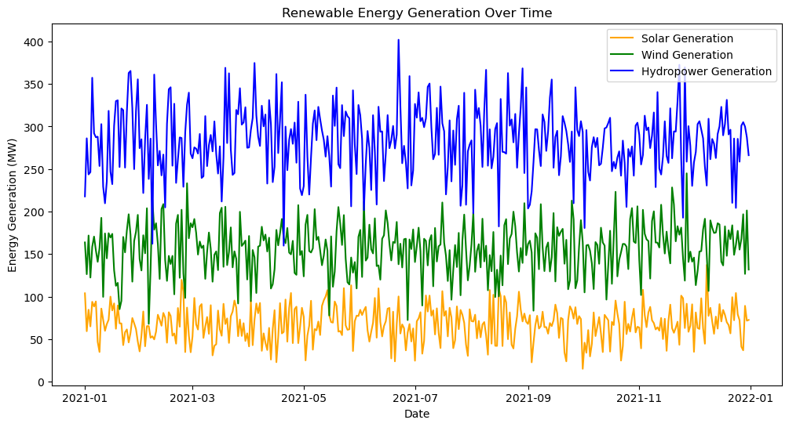
Effect of Humidity on Renewable Energy Generation:
Objective:
The objective of our analysis is to investigate how humidity levels affect the production of renewable energy. By simulating synthetic data and visualizing it over time, we aim to uncover potential correlations between humidity and energy generation from different renewable sources.
The x-axis represents time, with dates or timestamps indicating the time period covered by the data.
The y-axis represents the amount of energy generated, usually measured in megawatts (MW).
In our case hydropower facilities may have higher capacity and/or are more consistently operational compared to solar and wind energy systems.

